Slide 1
The Future of Cator Hall July 2024 Directional Consultation Presentation

Slide 2
Background and Current status
Parish council decided to buy Cator Hall
This was a major investment for the village
The cost of the hall was over £50,000
An additional £20,000 investment was made in the kitchen
A total investment of over £70,000
This has made Cator hall a key strategic asset for the village:
A potential centre for village life
The heart of community events and activity
The living heart of the village and all its residents
An investment to be used by all
There are two choices available for this asset
Low investment/ low use/ liability
Invested/ high use/ heart of the community model
This asset needs to deliver a return on this social investment
Not become a financial drain
Not to fall into disrepair
Not to become a barely used asset
Not to become the ‘property’ of the council or any individual or group
Not to become a centre for conflict or frustration
What has happened since this asset was purchased?
Has returned very little in rental revenue
Rental income does not cover the costs
Hasn’t been well maintained
Apparent fear of investment -Poor décor and maintenance
Not fully compliant with legislation?
Garden/ outside area neglected
Investments made have not delivered a return
Furniture is good but designed for temporary use
Facilities are not necessarily meeting the needs of potential new customers
Improved furniture needed to supplement the current furniture
Lighting and acoustics do not create a warm and convivial atmosphere
No design or plan to attract and embrace new revenue streams
Stuck in the ‘two empty rooms’ mindset ( rules?)
Increased usage has created tension, conflict and fear
Miscommunication
Misunderstanding
Friction and bad feeling

Slide 3
What are the options?
Continue with low risk/ low investment approach
Limited investment
Turn away lucrative bookings
Stay a church hall with limited potential
Not contribute to building village events
Continue to lose money every year
Cycle of decline
Needs propping up year on year
Becomes used less and less
Does not return on its £70,000 investment financially or socially
Decays and becomes a burden
Invest in making Cator Hall the heart of village life
Develop an investment plan that develops Cator Hall’s potential
Improve the offering to attract incremental revenue
Ensure the Hall has the infrastructure and offering to meet the potential needs of customers
Provide a PRS licence to enable music to be played
Provide audio visual/ TV / Light show equipment and licensing
Provide a premise licensing solution that unlocks major revenue streams
Invest revenues in bigger and better events and activities
Enable activities for young and old and all in between
Enable a wider range of activities
Ensure Cator Hall truly does “Cator 4 all”
Cycle of growth and engagement
Become self funding over time
Three sources of revenue – Rental, sponsorship and retail sales
Becomes the heart of village life and major events
Links with our other great assets
The daffodil
The Playing fields
Our great landmarks and surrounding countryside

Slide 4
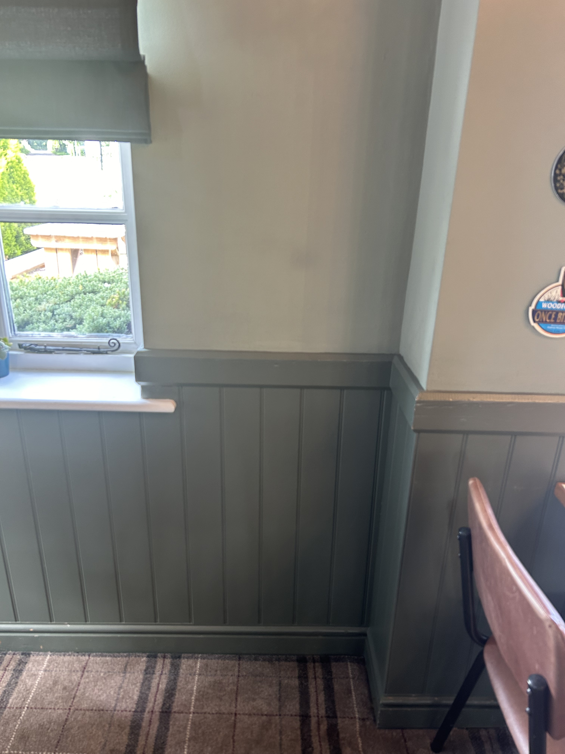
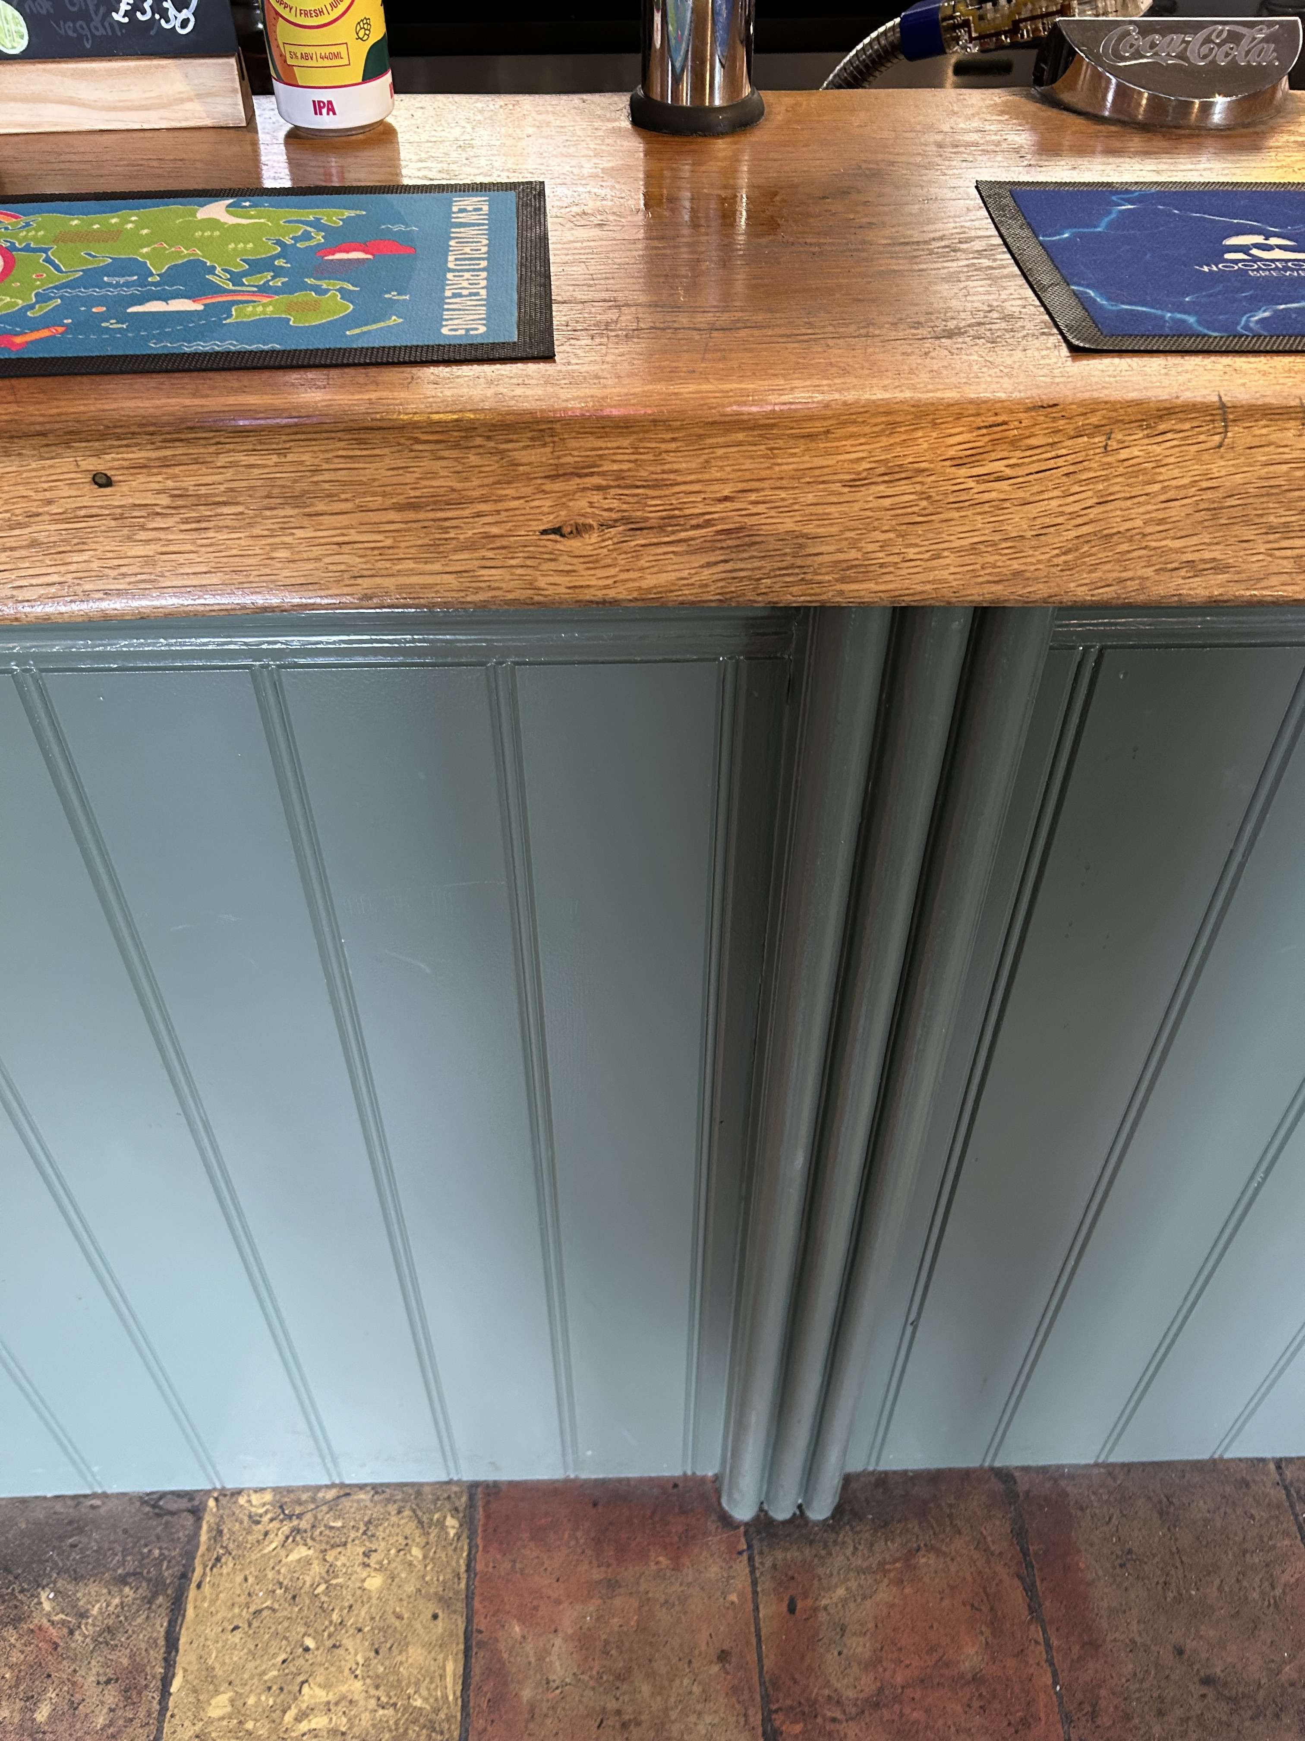
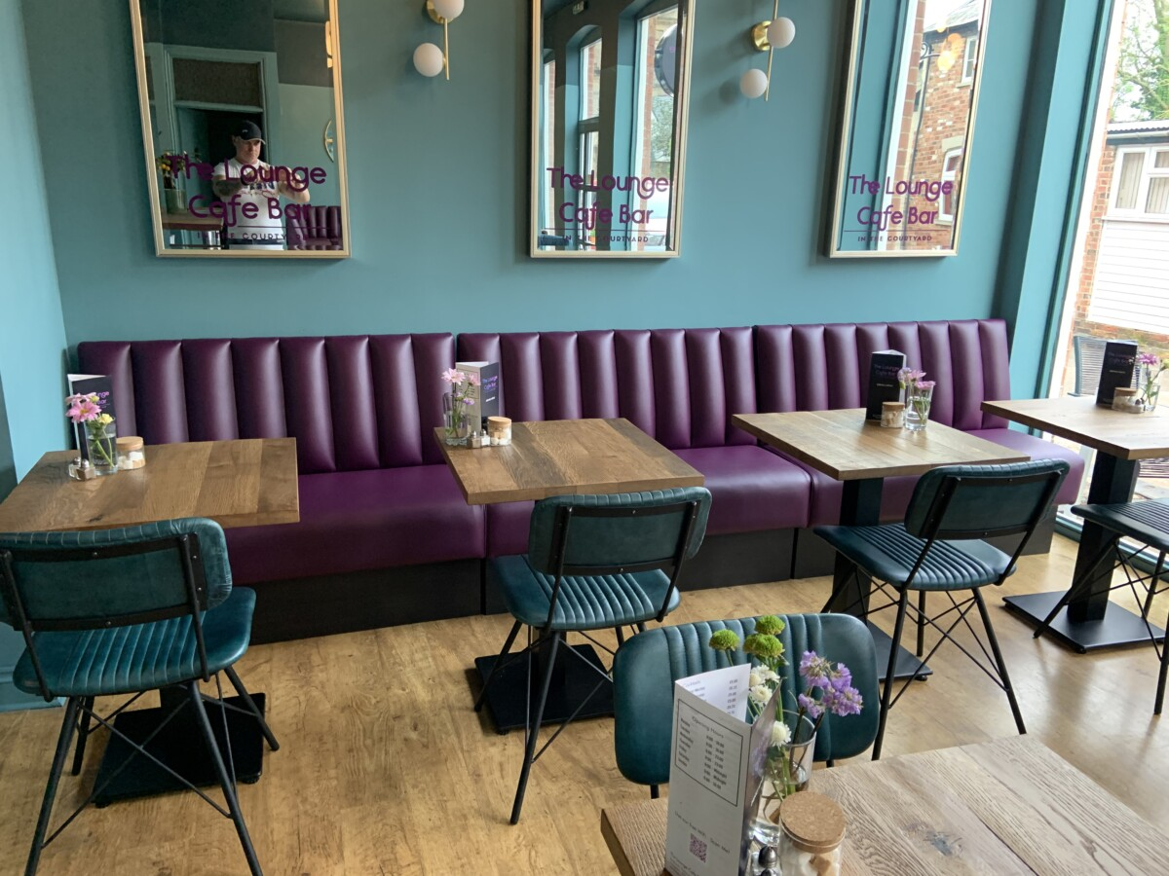
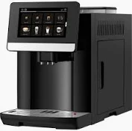
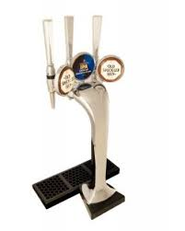
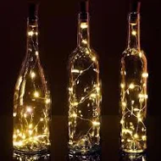
Investing to Create a Great Community Hub
Mood Board
Oak Room Café Bar
Refurbished into a high spec facility
Wood panelling
Relaxing shades of green favoured in hospitality
Enhanced bar area with new oak top
Larger bar surface area
Furniture that fit the space better and creates more comfort
Improved lighting, blinds and acoustics
Designed space for crockery, glassware and cutlery
Wall mounted flat screen TVs
Commercial (easy use) coffee machine
Great for use when the Daffodil isn’t open
28-32 seater designed to suit its use
Can be used separately or part hall hire
Designed to create a great space for:
WI Meetings
Craft fair tea room
Christenings and wakes
Ruby Tuesday afternoons
Community evening café bar (not a pub)
Sports events
Re decorate the hall to create a great facility for booking and events
Customer centric approach
Sliding scale rentals
Lighting systems
Audio visual offerings
Configuration planning to help customers
Event plans

Slide 5
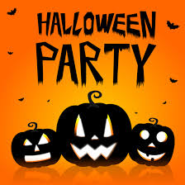
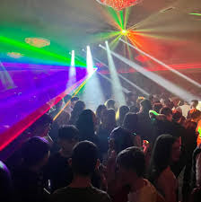
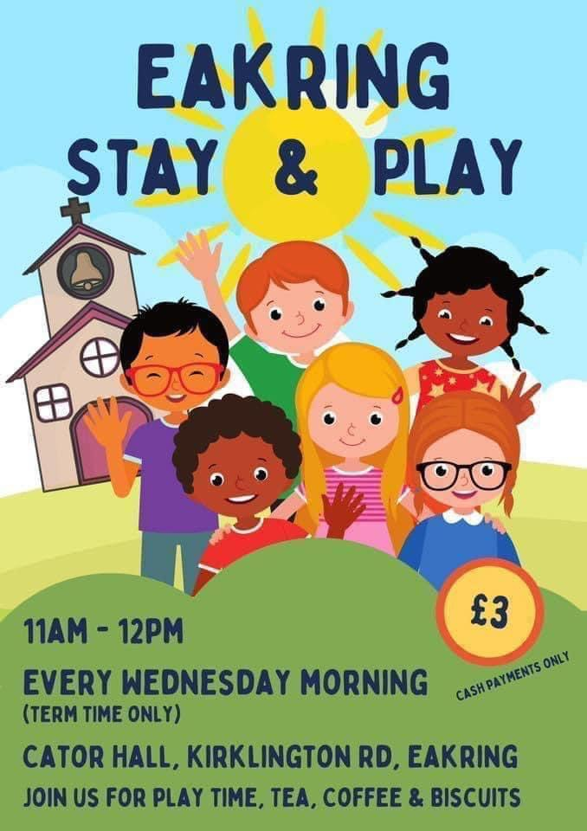
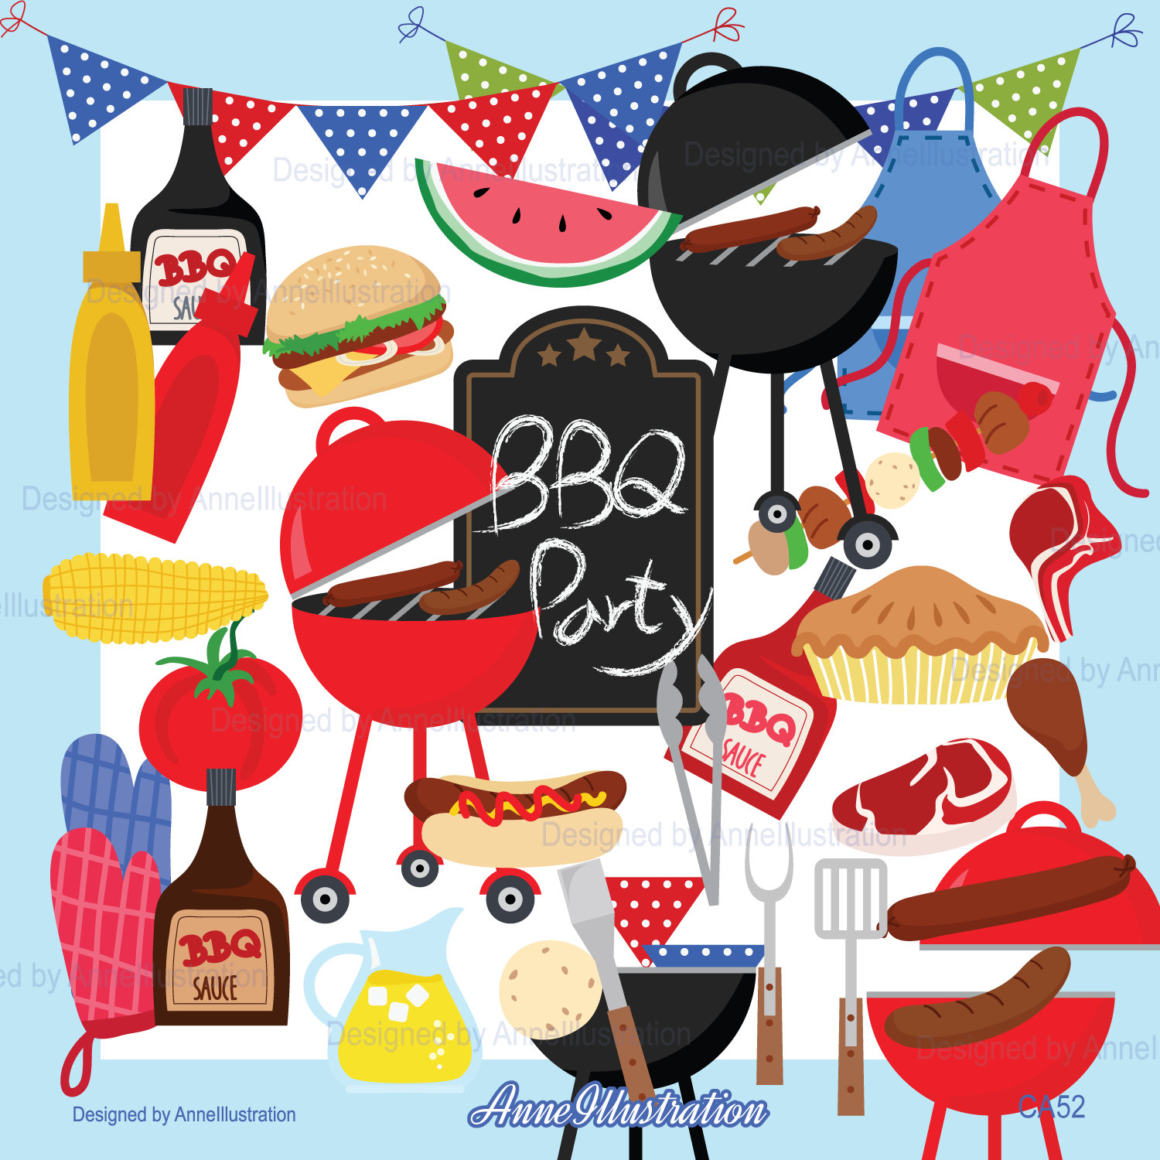
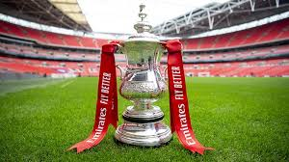
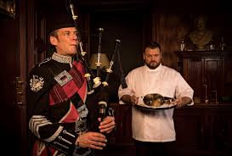
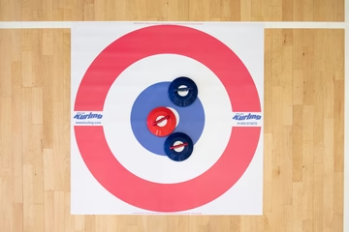
CATOR 4 ALL - The of Our Village
Ruby
Tuesday
Club

Slide 6
Cator Hall - Cator 4 all
Appoint a management committee to create a “Cator 4 all Plan” ( up 5 people plus 1 PC)
Develop an investment plan to create an attractive space
Attract sponsorship
Use council funds/ grants
Encourage community support and engagement
Create a permanent Oak room facility that is inviting
Small traditional tables and chairs, curtains, panelling and attractive paint scheme/ Improve lighting
Create a Main Hall that is multi-functional and attractive
Improve acoustics/ improve decoration/ celebrate history
Invest in the garden area at some point
Management committee to manage the booking diary and ensure fair and equal access for all
Increase revenues and invest in bigger and better events for young and old
Summer BBQ, Youth Disco’s, Childrens Easter, Christmas, Halloween parties, Village Movie events, casino/race nights, Senior afternoon social events
Apply for a premise license to facilitate upwards of £10k of incremental revenue
Management committee to recruit volunteers to operate bar facilities at events/ community pub etc.
Management committee to manage bar and receive revenues and margin on behalf of the Council
Providing a multi licenced venue
Provision of a PSR licence to enable music
Provision of TV’s and TV licence
Provision of Audio Visual and lighting for parties, disco’s etc.
As a community asset the Management committee can apply for a premise licence
Thousands of village halls operate a premise licence without a problem
The parish council and councillors are not legally responsible
The management committee take ownership on behalf of the council
Councillors do not need to attend any courses
You do not need a designated premises supervisor
The management committee will designate trained volunteers to operate the licence
There are plenty of willing volunteers
A premises licence is needed as a core offering to meet the demand for licenced events
There is strong demand for over 40 licensed events a year with only 15 Temporary event notices available
The choice is a premise licence or a dry hall
A licenced bar can generate over £10k in revenue a year
Bar revenue can help to keep rental affordable
Management committee take control of bar revenues and margins ( circa £200 margin per event)
Revenues can be used to create bigger events, pay for Youth disco’s, Childrens Christmas parties, village movie events etc.

Slide 7
Cator Hall Usage Output
Uninvested
6 wine club nights ( at risk due to licensing regulations)
2 craft fairs
WI events
Stay & Play ( currently supported by END’s)
Invested
wine club nights
Craft Fairs
Wi events- Quiz night, Kurling etc.
Stay & Play
Youth disco nights
Senior “ Ruby Tuesday” Socials/ tea dance
Burns Night event
St Patrick’s event
Easter Childrens Party
St George’s event
Village Movie day/ Nights
Village summer BBQ
Village Harvest Ball
Childrens Halloween Party
Casino/ Race night events
Village Christmas bake off
Village Childrens Party
Village New Years eve Party
Community Café bar

Slide 8
Cator Hall Management Committee
Process
Council Appoints Management committee
Council agree terms of reference
Meet with key customers
Management committee proposes a plan
Council Reviews and supports plan
Village Open day to review plan
Implement the plan
Parish Councillor Chair
Parish Councillor Deputy Chair
Licencing DPS
Beth
Customer Service
& Marketing
Event Planning, eventually x 2
Volunteers ( includes committee)
To support events and activities
Parish Council

Slide 9
Summary
The Parish council chose to invest £70k in Cator Hall
That investment needs to deliver a financial or social benefit
The status quo is not a sustainable model
Limited investment brings limited use and a spiral of decline
There are opportunities for increased use
We need to provide a great facility with a desirable offering to attract revenue
There are willing people to volunteer and operate as a management committee for the council
To create and deliver an investment plan
There are willing people able and qualified to deliver the vision
There are willing people to create great events and activities to increase the use of the facility
The vision is CATOR HALL - CATOR 4 ALL
Increased and differential use does not impact on historic and current users
The church, Women’s institute, Wine Club, Craft Fair, Stay & Play etc. will all continue to be core users of the hall with fair and equal access

Slide 10
Next Steps
Acoustics and decoration plans already in motion for completion in July and August
Gain feedback and answer questions today
Appoint councillor to lead the Cator Hall committee
Agree terms of reference
Committee chairperson to meet key customers 1-2-1 to discuss needs
Finalise plan and budget for council approval in August
Finalise refurbishment
Recruit management committee and volunteer team
Review user terms and agreements
Create plan for security and access
Create plan and budget for council approval
Brief customers on term and conditions with a proposed change January 2025
Implement plan

